Slide 1
Fifth Integrated Household Living Conditions Survey
2016/17
Official Dissemination
National Institute of Statistics of Rwanda (NISR)
6th December 2018

Slide 2
Outlines
Context
Key Findings
Conclusion and Policy Perspective

Slide 3
Context
This is the fifth EICV following previous ones in 2001, 2006, 2011 and 2014.
Covers poverty trends and wide scope of living conditions statistics.
Quite instrumental in understanding poverty dimensions and useful in guiding policy towards poverty reduction.
Done every three years.

Slide 4
Details on poverty and living conditions
Rwanda Poverty Profile Report
Rwanda Poverty Panel Report
VUP Panel Report
Multidimensional Poverty Report
Multidimensional Child Poverty Report
Gender Thematic Report
Youth Thematic Report
Economic Activity Thematic Report
Education Thematic Report
Utility and Amenities Thematic Report
Environment and Natural Resources Thematic Report
Main Indicators Report
With details for districts and rural/urban statistics

Slide 5
Key Dimensions of Poverty
Food availability
(Production)
Food accessibility
(Price and inflation)
Other necessities and their price
Favorable social-economic environment
About 70% weight
About 30% weight

Slide 6
GDP Per Capita (Current US$)
Average Growth 7.5% per Year

Slide 7
NISR Establishment Census 2011, 2014 & 2017.

Slide 8
Net Jobs Created between 2017 and 2018
Total Jobs: 206,190
Non Farm Jobs: 166,058
Farm Jobs: 40,132
Source: Labor force surveys 2017 - 2018

Slide 9
Source: Labor force surveys 2017 - 2018

Slide 10
Households Improving Living Conditions (%)

Slide 11
Some Stagnating Areas

Slide 14
Inflation

Slide 18
Poverty and Extreme Poverty

Slide 19
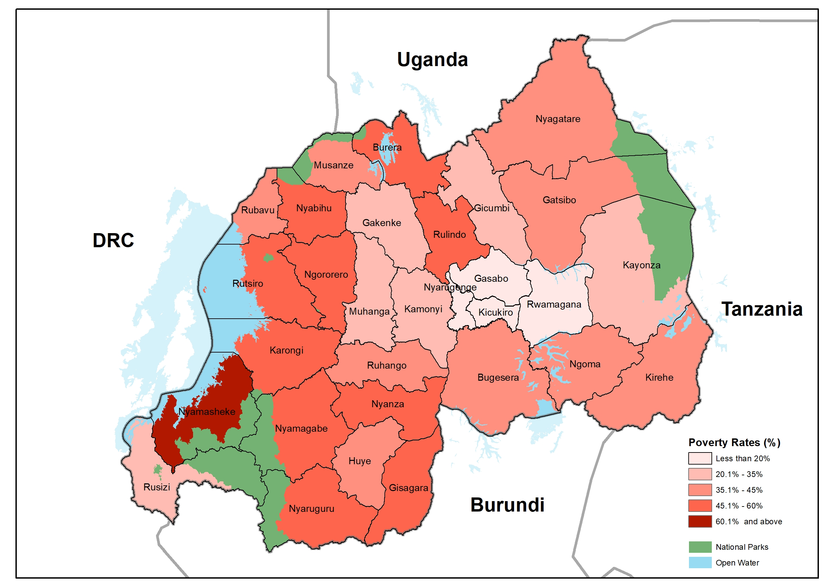
Poverty Map Rwanda

Slide 20
District Poverty Ranking
No. | District | Poverty (%) |  | No. | District | Poverty (%)
30 | Nyamasheke | 69.3 |  | 15 | Bugesera | 40.3
29 | Gisagara | 55.6 |  | 14 | Huye | 40.2
28 | Rulindo | 54.2 |  | 13 | Ruhango | 38.0
27 | Karongi | 52.7 |  | 12 | Ngoma | 37.8
26 | Nyaruguru | 52.4 |  | 11 | Rubavu | 35.7
25 | Burera | 49.8 |  | 10 | Gicumbi | 34.7
24 | Rutsiro | 49.5 |  | 9 | Gakenke | 34.2
23 | Nyamagabe | 48.6 |  | 8 | Rusizi | 33.5
22 | Ngororero | 47.7 |  | 7 | Muhanga | 32.6
21 | Nyabihu | 46.8 |  | 6 | Kayonza | 26.7
20 | Nyanza | 46.5 |  | 5 | Kamonyi | 22.3
19 | Nyagatare | 44.8 |  | 4 | Rwamagana | 18.9
18 | Kirehe | 44.6 |  | 3 | Gasabo | 15.8
17 | Gatsibo | 42.1 |  | 2 | Nyarugenge | 11.8
16 | Musanze | 40.7 |  | 1 | Kicukiro | 11.4

Slide 21
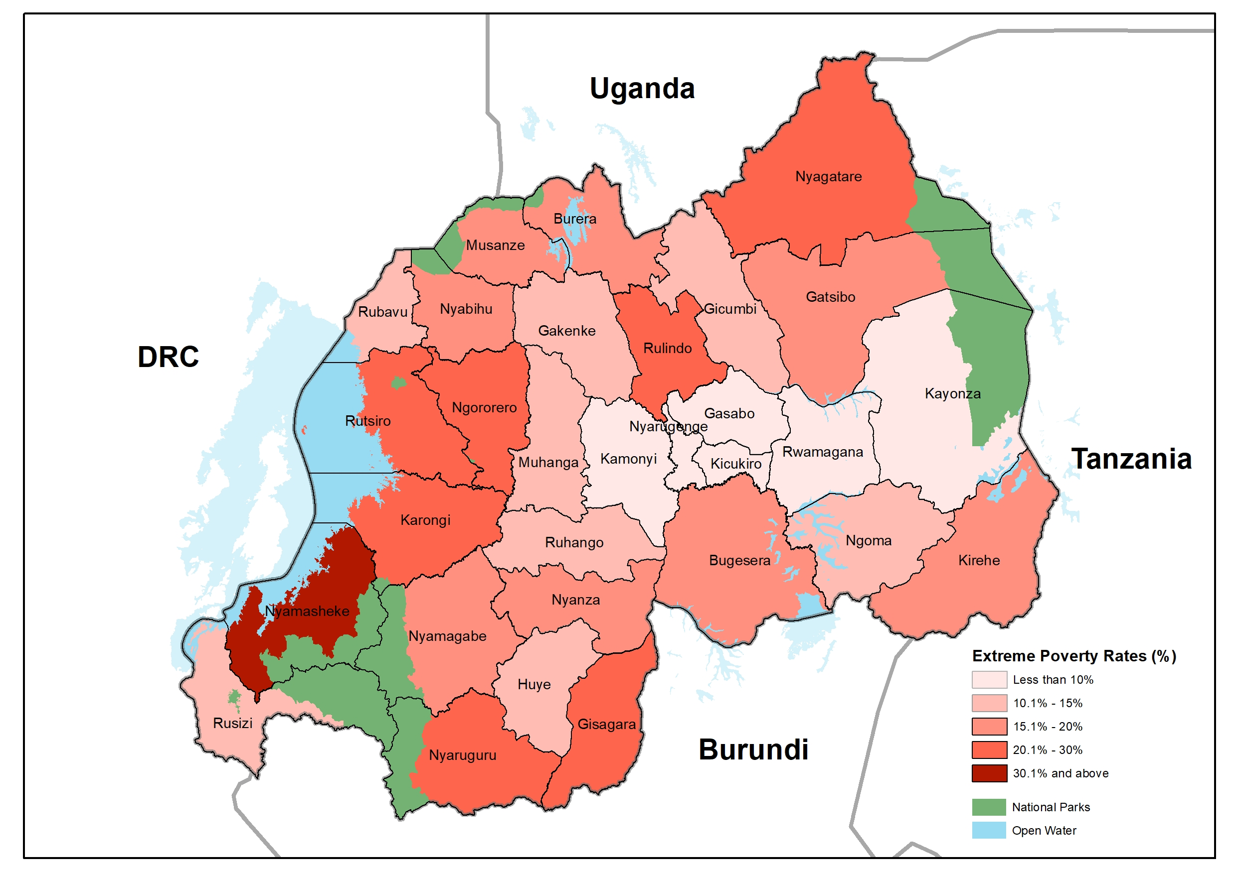
Extreme Poverty Map Rwanda

Slide 22
District Extreme Poverty Ranking
No. | District | Extreme Poverty |  | No. | District | Extreme Poverty
30 | Nyamasheke | 41.5 |  | 15 | Nyanza | 16.0
29 | Nyaruguru | 28.1 |  | 14 | Ruhango | 15.0
28 | Gisagara | 25.6 |  | 13 | Rubavu | 14.6
27 | Rutsiro | 24.4 |  | 12 | Ngoma | 14.0
26 | Rulindo | 23.2 |  | 11 | Muhanga | 13.8
25 | Karongi | 21.3 |  | 10 | Gicumbi | 13.4
24 | Ngororero | 20.8 |  | 9 | Gakenke | 13.1
23 | Nyagatare | 20.1 |  | 8 | Huye | 12.9
22 | Burera | 19.9 |  | 7 | Rusizi | 12.8
21 | Gatsibo | 18.8 |  | 6 | Kamonyi | 8.7
20 | Kirehe | 18.5 |  | 5 | Kayonza | 8.5
19 | Musanze | 18.1 |  | 4 | Rwamagana | 4.8
18 | Nyabihu | 18.0 |  | 3 | Nyarugenge | 4.6
17 | Bugesera | 17.8 |  | 2 | Gasabo | 4.5
16 | Nyamagabe | 17.7 |  | 1 | Kicukiro | 3.5

Slide 23
Inequality (Gini Coefficient)

Slide 24
The 2016/17 drought (shock) was experienced by many countries in the region. A few countries however monitor poverty regularly, among them is Uganda and Malawi. Below is a comparison of the effect on poverty. While poverty increased slightly in both, it reduced slightly in Rwanda. The reduction in Rwanda is not statistically significant.

Slide 25
Conclusion
Overall, EICV5 results allow us to have a comprehensive understanding of changes in living conditions of Rwandans including poverty since 2014.
From the results, we see that most livelihood dimensions continue to improve; from demographics, housing conditions, economic activity, access to electricity and technology among others.
Some few but key livelihood dimensions like education are stagnating.
However, a substantial number of Rwanda’s households experienced shocks (drought, high food prices and others) before and during the survey period.
Poverty and extreme poverty did not reduce significantly.

Slide 26
Policy Perspective
There is need to put in place mechanisms that mitigate potential shocks specifically economic and those related to climate change.
There is also need to strengthen social protection safety nets that support households affected by shocks

Slide 27
Thank You

